Slide 1
COVID-19 Analysis:
Exploring International Trends in COVID-19 Cases and Deaths
Haley Miller, Maggie Samaan, Richard Hamilton, Aishwarya Karthik

Slide 2
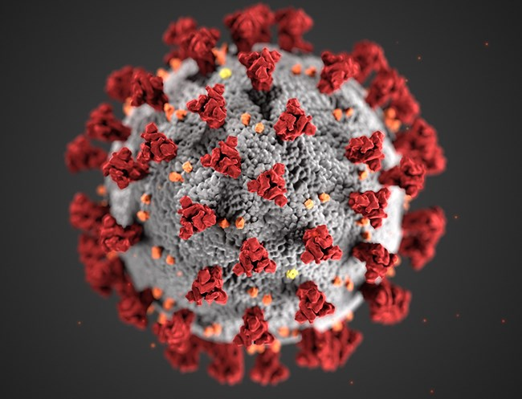
COVID-19 Analysis
Background
As COVID-19 persists throughout the globe, the purpose of this exploration is to determine the relationship between different factors that contribute to the spread of COVID-19 as well as the outcomes noted by people across the world.
CDC/SCIENCE PHOTO LIBRARY

Slide 3
Purpose of COVID-19 Analysis
By analyzing these health outcomes, the goal is ultimately to predict the health outcomes in future populations based on the factors determined significant by the machine learning model utilized below.

Slide 4
Data Source
Our World in Data
Data
An organization that focuses on researching international crises including issues like climate change, war, and disease
Combined data from across the world to include country, continent, new COVID-19 cases, total COVID-19 cases, population, age, and several other factors in reference to the COVID-19 pandemic

Slide 5
Questions to be Answered by Analysis
Question 1
Question 2
What differences exist between the health outcomes of people from different countries?
How can future health outcomes be predicted from this data?

Slide 6
Analysis

Slide 7
Data Loaded
Database created and loaded
Visualizations Created
Exploratory Analysis
Preprocessing of Data and Running ML

Slide 8
Data Exploration
Exploratory analysis was completed to better understand the data. Utilizing Python, the data was explored to determine the nature of each column, the number of values contained in each column, and the significance of each column. For example, exploration included listing the number of entries per country and the number of missing values per country.

Slide 9
Data Exploration (cont.)
Challenge 1
Challenge 2
Challenge 3
Not all rows contained the same format of data
E.g. multiple continents were listed within the location column which predominantly held the names of countries
There were several null values within the dataset
Not all null values could be dropped as it would severely diminish necessary data points

Slide 10
Database
Utilizing AWS, an RDS instance was created to access the data file located in an S3 bucket. PySpark was then used to load the data and create a column was added to act as an identifier for the various rows of data (“id_row”). Following, the data type of the “date” column was changed to accurately indicate the date data type. From there, the data was split into two dataframes (cases_data and demos_data) to reflect data relating to the COVID-19 cases and the data relating to the demographics of individuals diagnosed with COVID-19, respectively. Lastly, PySpark was used again to load the dataframes into Postgres tables.

Slide 11
Database
Using Postgres, the cases_data and demos_data tables were joined on the “id_row” column with a full outer join into the table combined_COVID_data. The data was filtered to only include valid countries within the location column and loaded into the table all_countries_data. A connection was made from the database to the next phase of analysis-the machine learning component. Please see the ERD below for the relationship between tables.

Slide 12
Machine Learning
Data was preprocessed and loaded into a neural network to predict future COVID cases.

Slide 13
Technologies, languages, tools, algorithms used
CEO
Wendy Writer
Dir. of Sales
Dir. of Engineering
Ronny Reader
Abby Author
North America Lead
Asia Lead
Europe Lead
Front End Lead
Back End Lead
Perry Presenter
Vinny Viewer
Molly Maker
Casey Creator
Berry Books

Slide 14
Technologies, languages, tools, algorithms used
- Software & Framework:Python (3.7.13), Jupyter Notebook (6.4.11), Anaconda (4.13.0), PostgreSQL (11.15-R1), pgAdmin4 (6.7), Spark (3.2.1), Visual Studio Code (1.65.0)
- Libraries & Packages: Pandas (1.3.5), matplotlib (3.5.1), NumPy (1.21.5), PySpark, JAVA, PostgreSQL driver, MLlib, Scikit-learn (1.0.2), Scikit-learn (0.23.2) for Ensemble Learning, imbalanced-learn library (0.7.0) tensorflow (2.3.0), keras-applications (1.0.8), keras-preprocessing (1.1.2), psycopg2 (2.9.3)
- Online Tools: AWS RDS, AWS S3, Google Colaboratory Notebooks, [COVID_19_Analysis GitHub Repository]

Slide 15
Questions
max growth
XX% sales increase

Slide 16
References

